Slide 1
CARDIO DISEASE PREDICTION

Slide 2
Problem Statement:
The major challenge in heart disease is its detection. There are instruments available which can predict heart disease but either they are expensive or are not efficient to calculate chance of heart disease in human. Early detection of cardiac diseases can decrease the mortality rate and overall complications. However, we can use various machine learning algorithms to analyze the data for hidden patterns. The hidden patterns can be used for health diagnosis in medicinal data.

Slide 3
Objective
In the modern era, approximately one person dies per minute due to heart disease. Data science plays a crucial role in processing huge amount of data in the field of healthcare.
As heart disease prediction is a complex task, there is a need to automate the prediction process to avoid risks associated with it and alert the patient well in advance.
The proposed work predicts the chances of Heart Disease and classifies patient's risk level by implementing different basic and advanced regression ML techniques. Thus, we aim to present a comparative study by analysing the performance of different machine learning algorithms .
This will promote prevention of disease and will help the patients to understand their physiology .

Slide 4
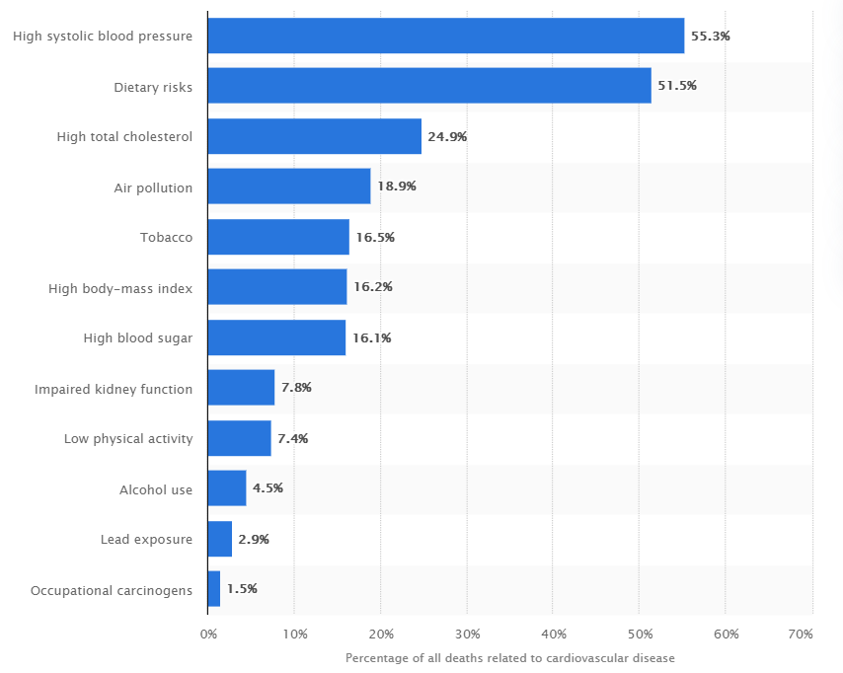
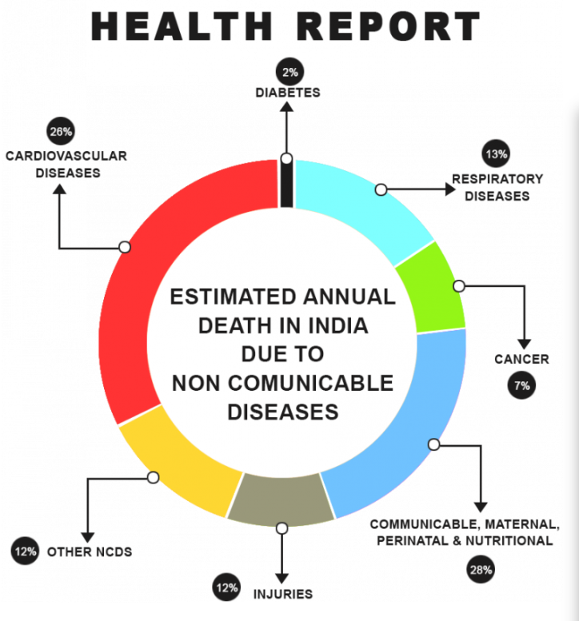

Slide 5
Data Set Link / Working Platform
https://www.kaggle.com/ronitf/heart-disease-uci
Jupyter Notebook / Google colab

Slide 6
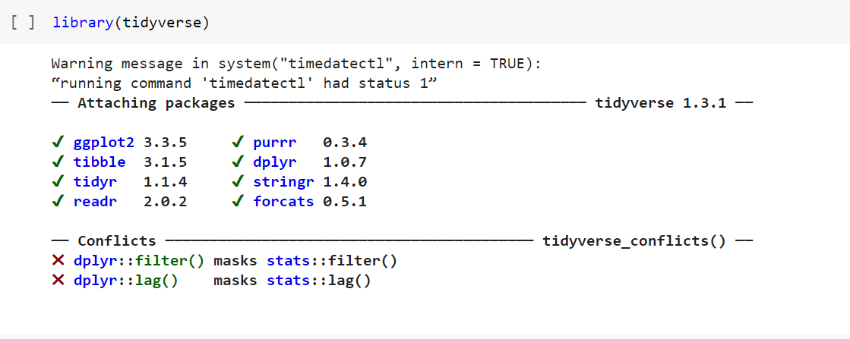
IMPLEMENTATION
Reading Dataset

Slide 7
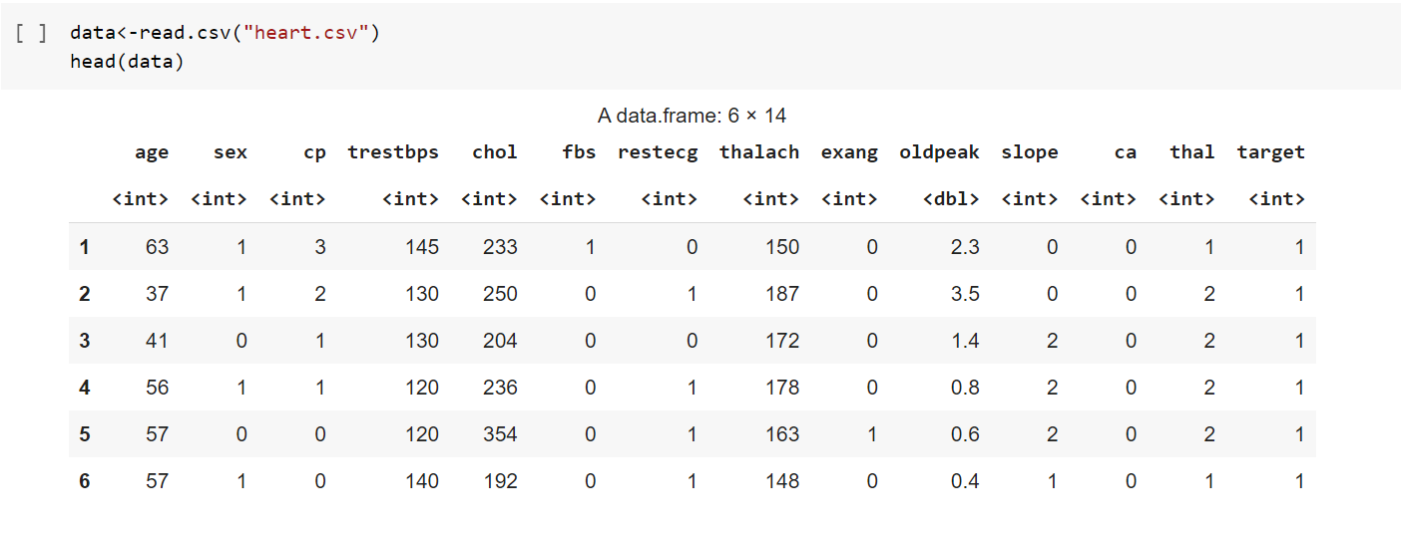

Slide 8
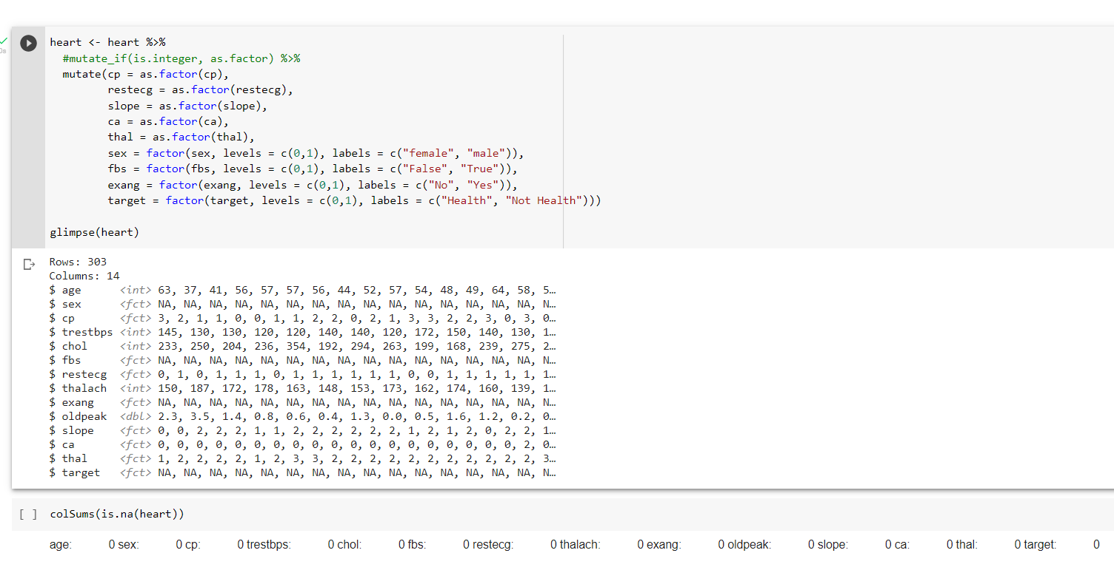
DataWrangling

Slide 9
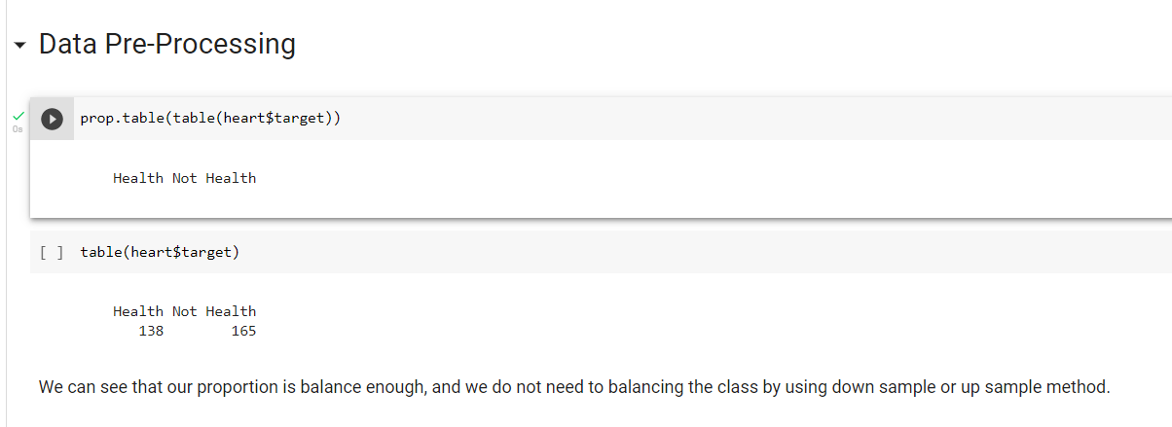
Data Pre-processing

Slide 10
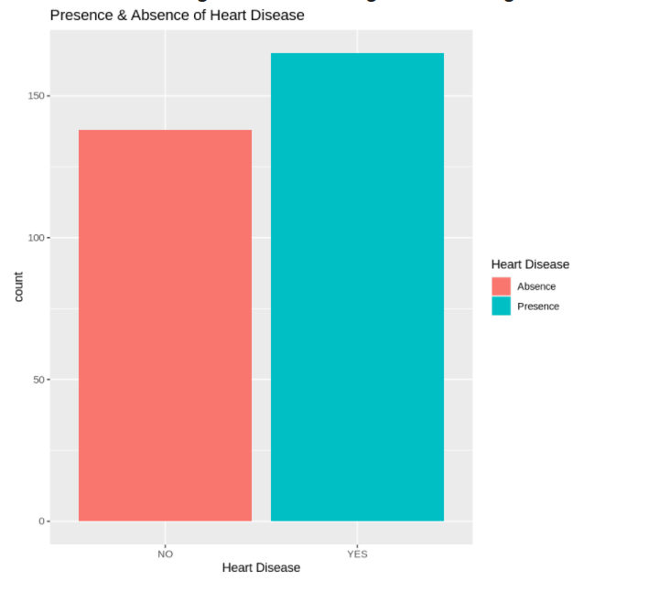
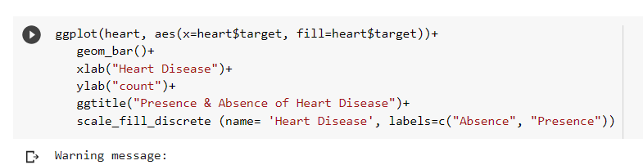
Data Visualization

Slide 11
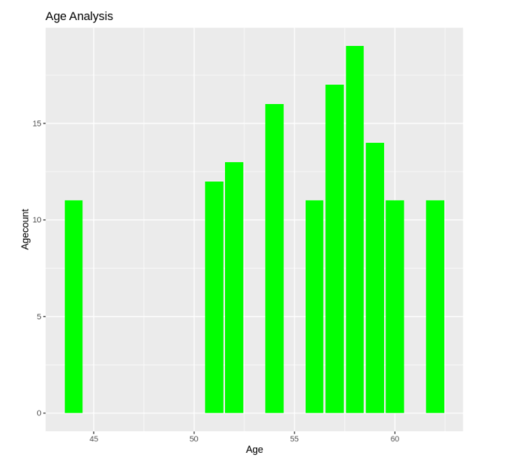
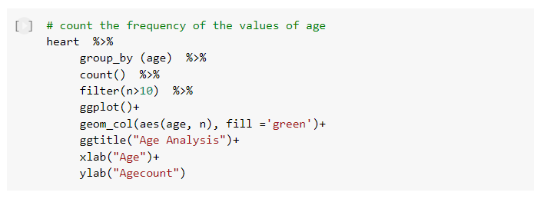

Slide 12
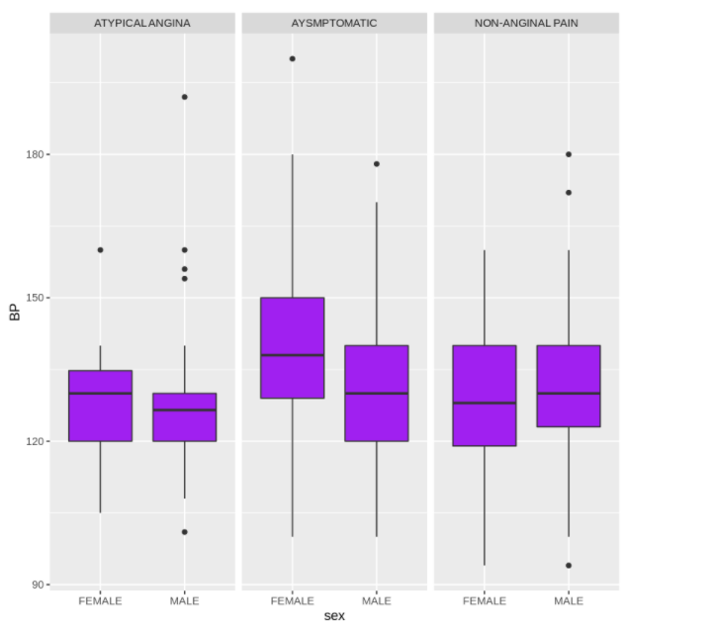
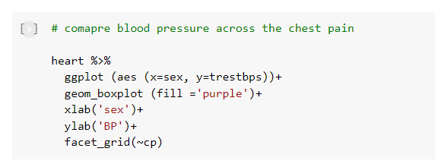

Slide 13
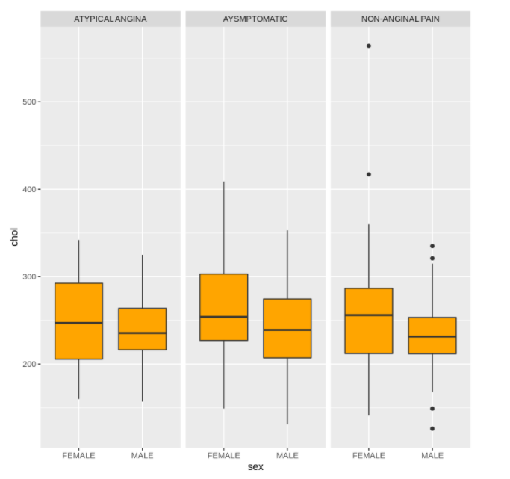
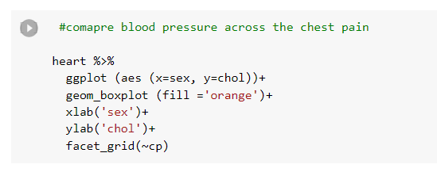

Slide 14
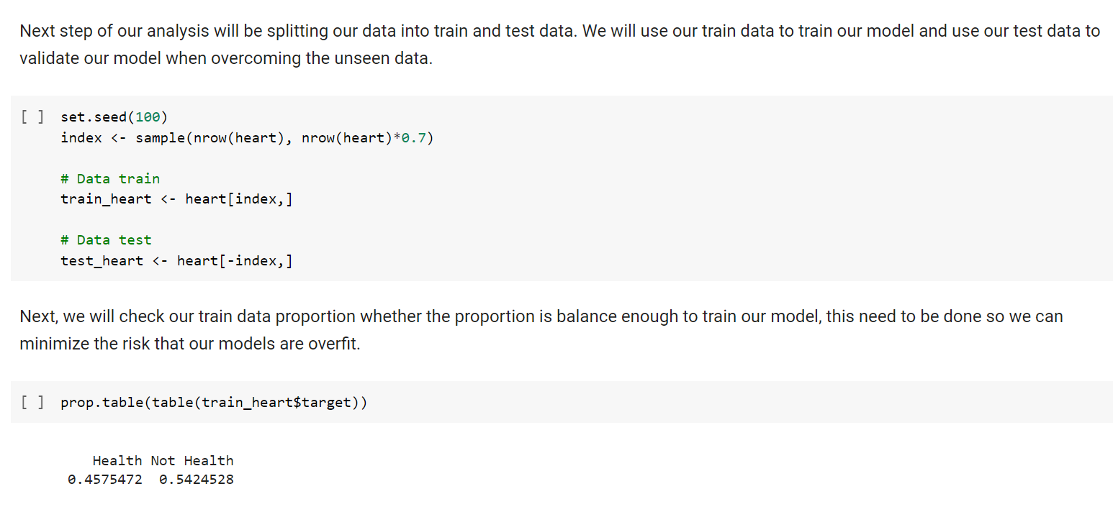
Cross Validation

Slide 15
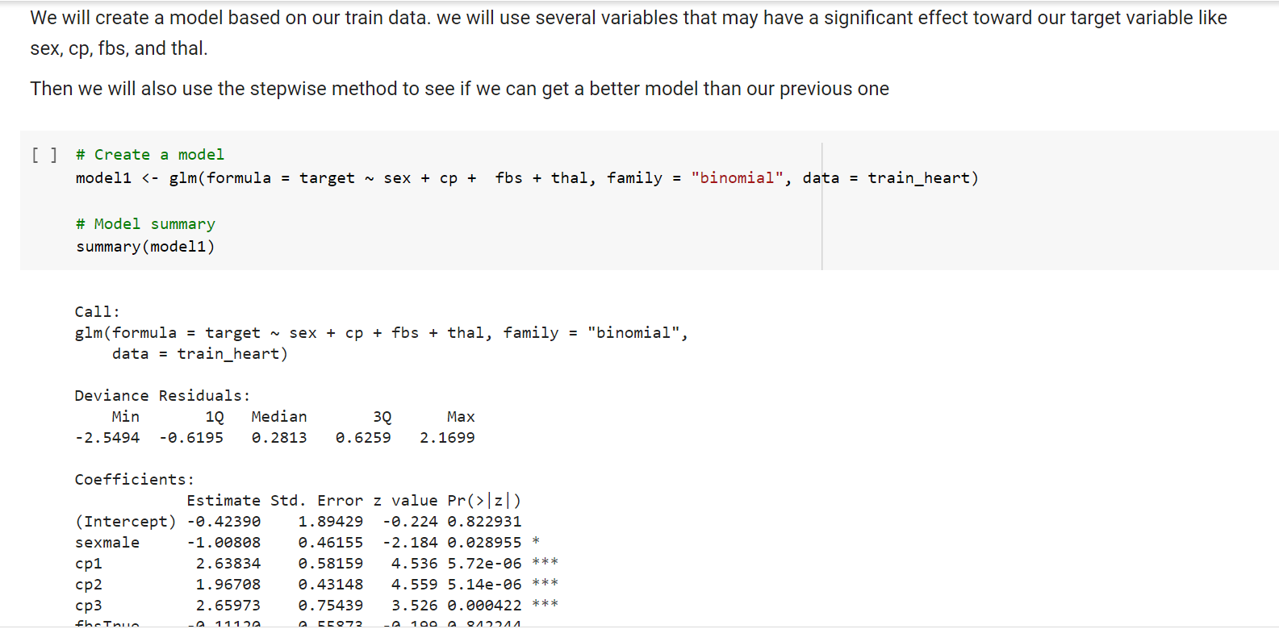
Modelling

Slide 16
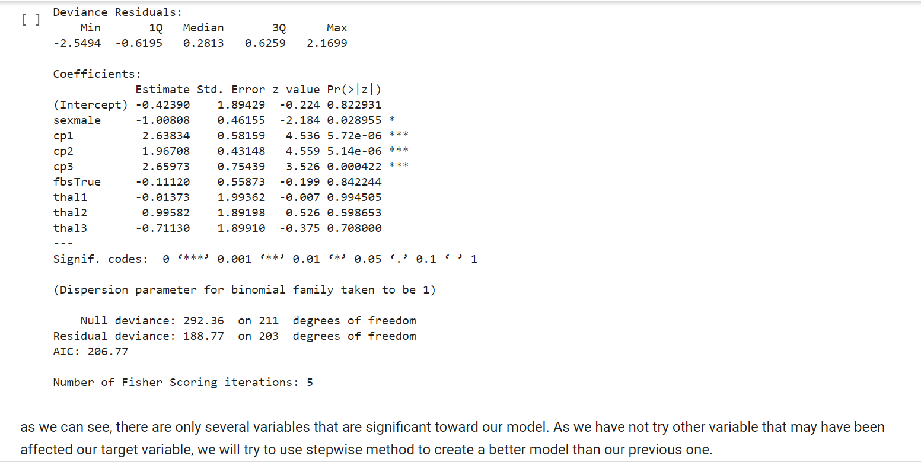

Slide 17
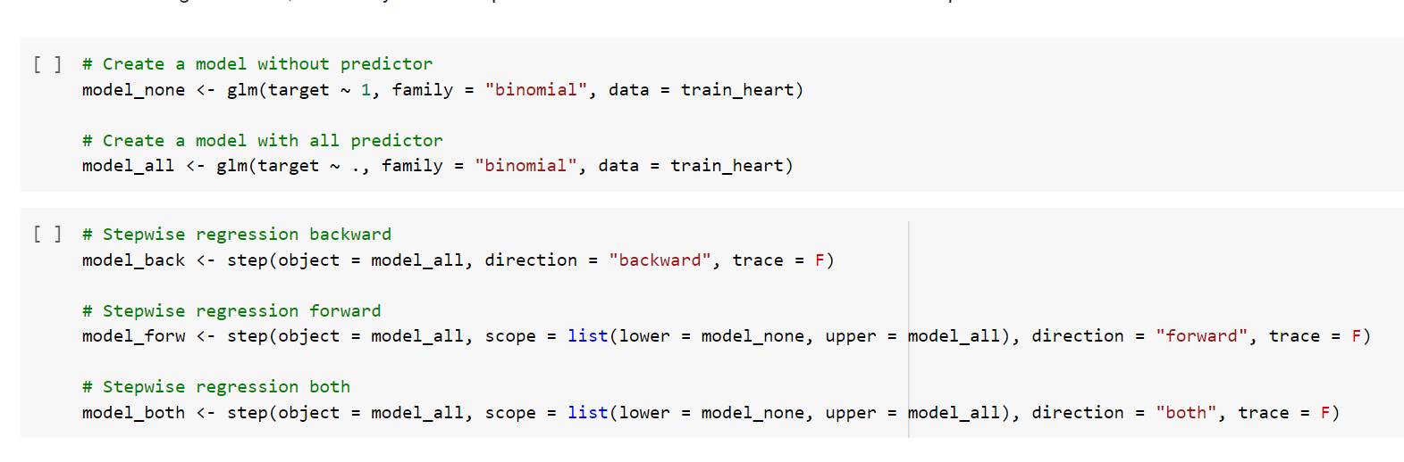

Slide 18
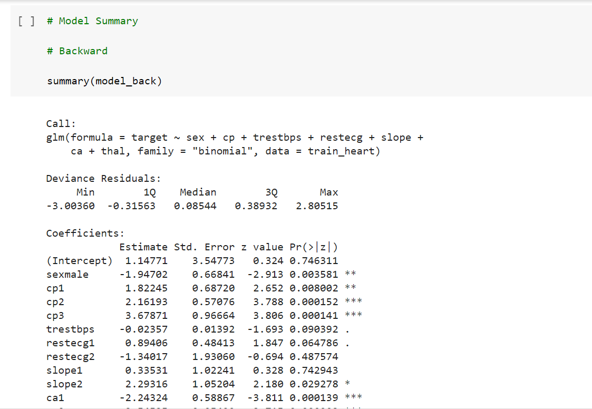
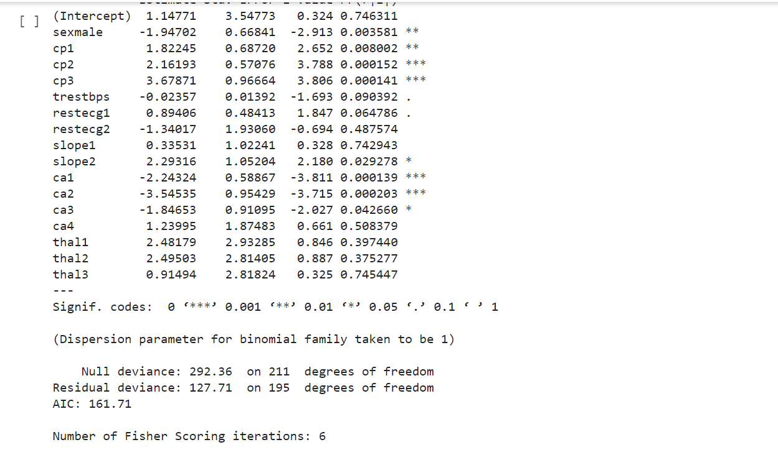

Slide 19
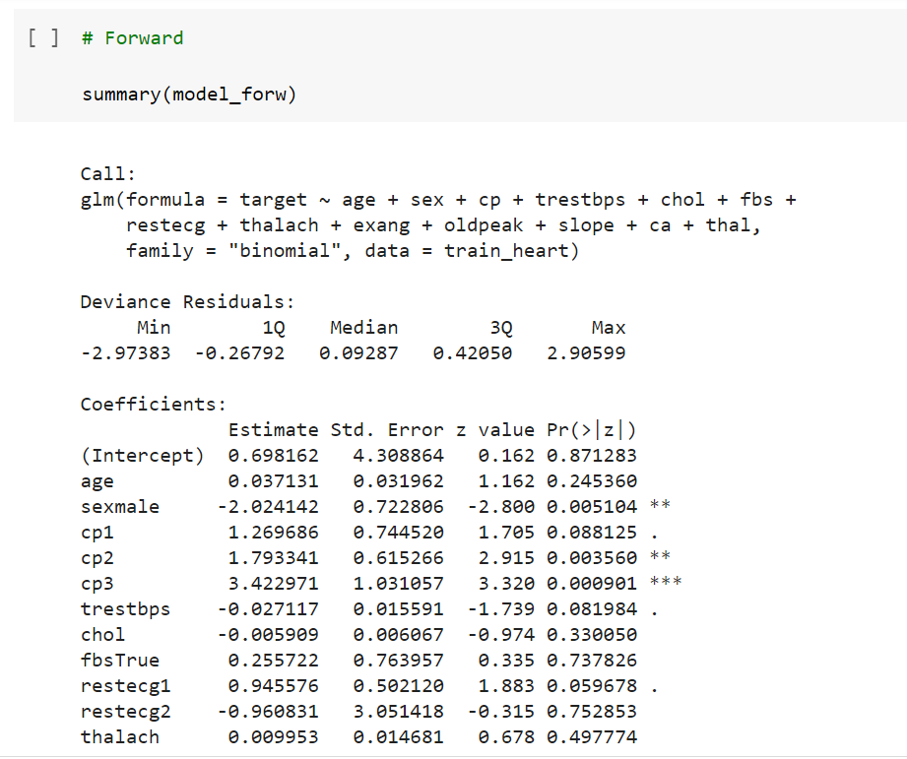
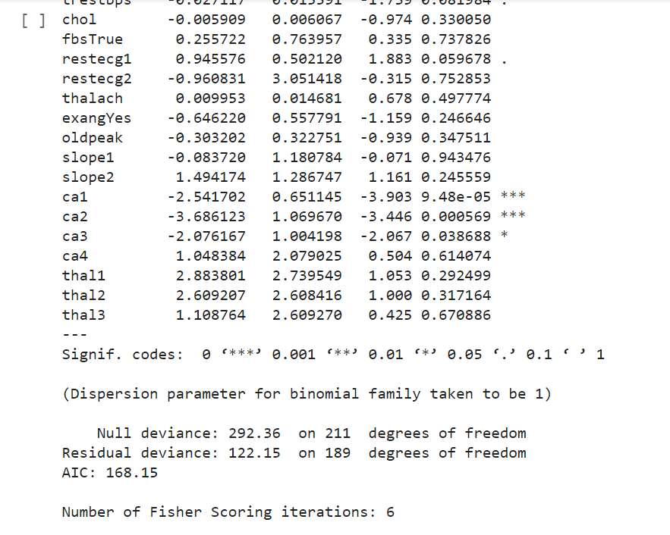

Slide 20
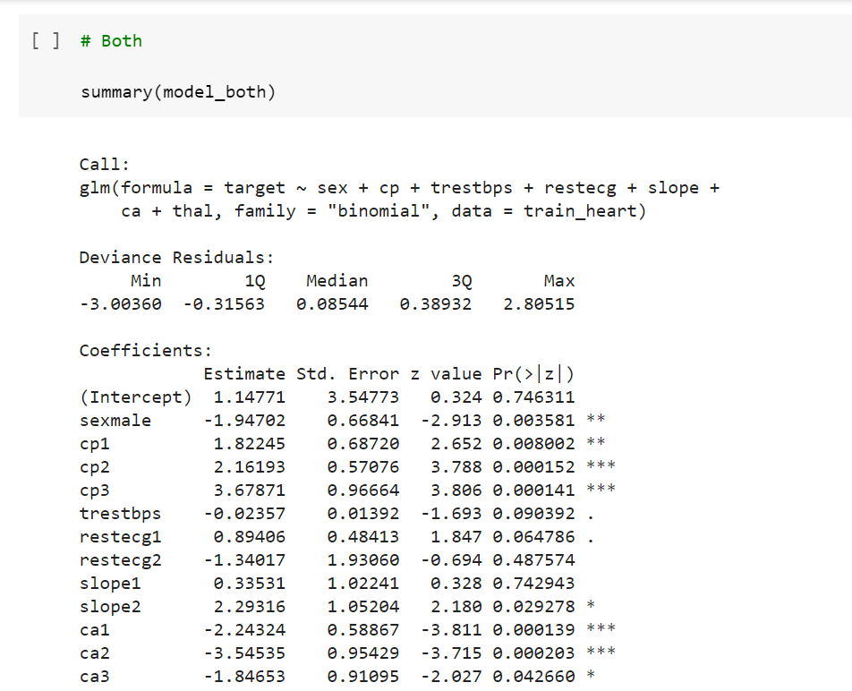

Slide 21
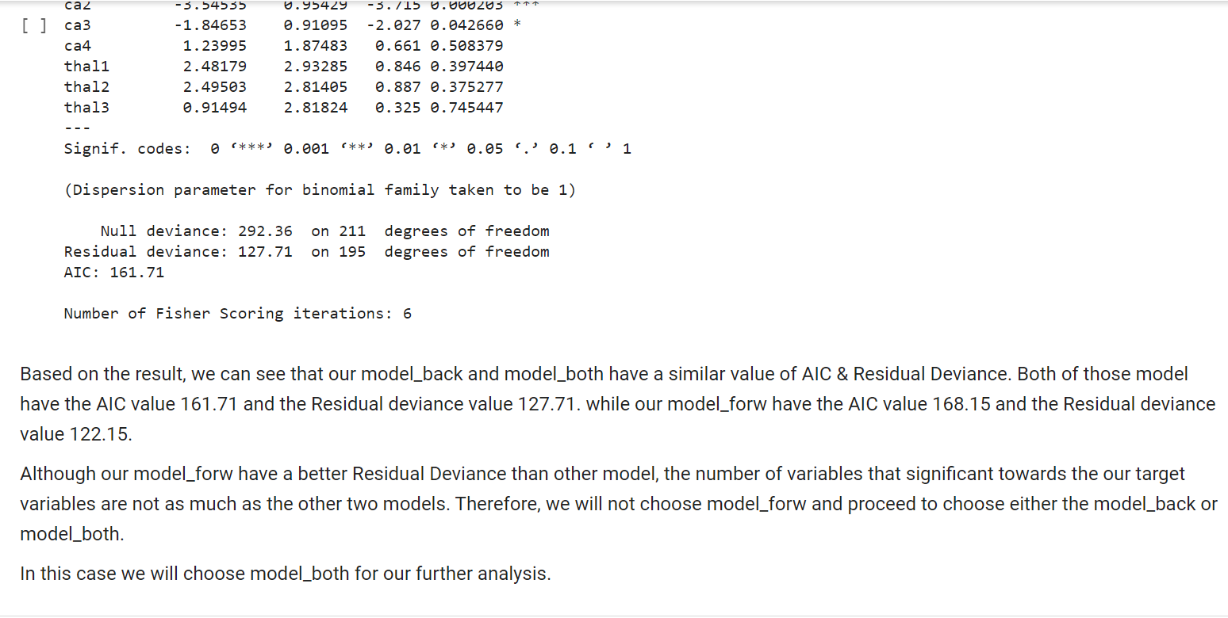

Slide 22
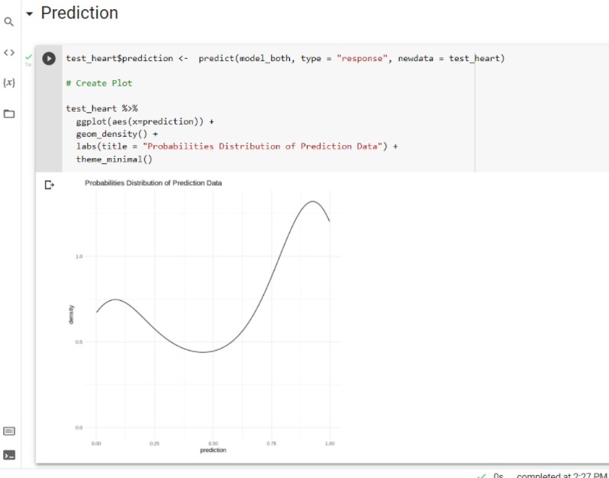
Prediction

Slide 23
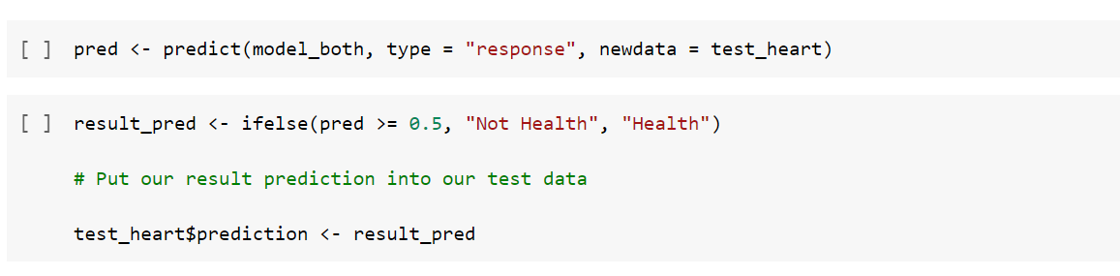
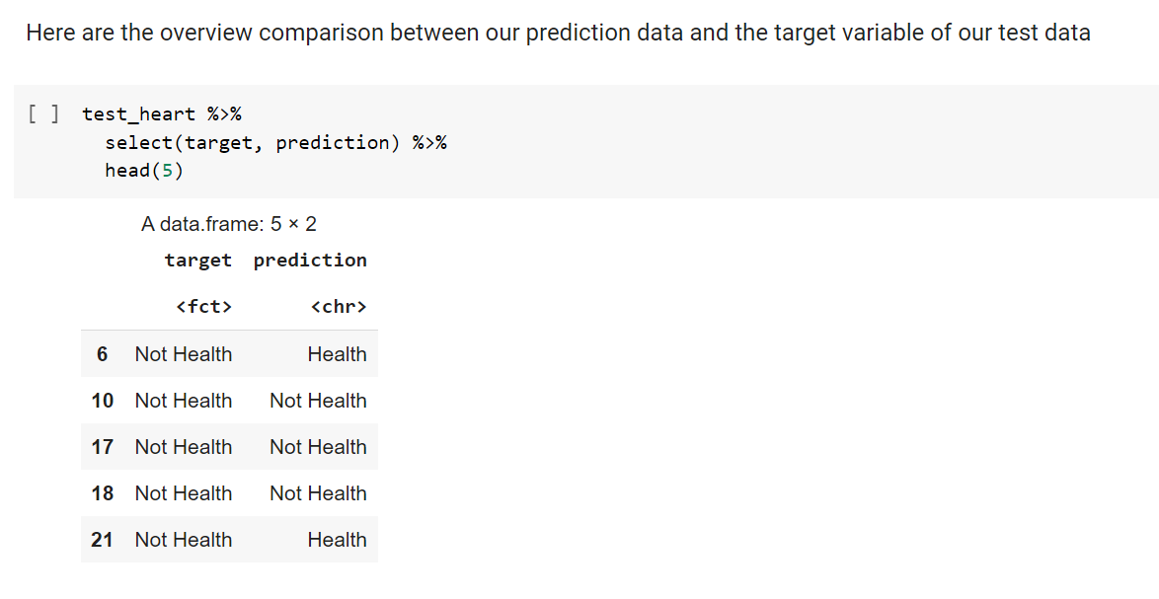

Slide 24
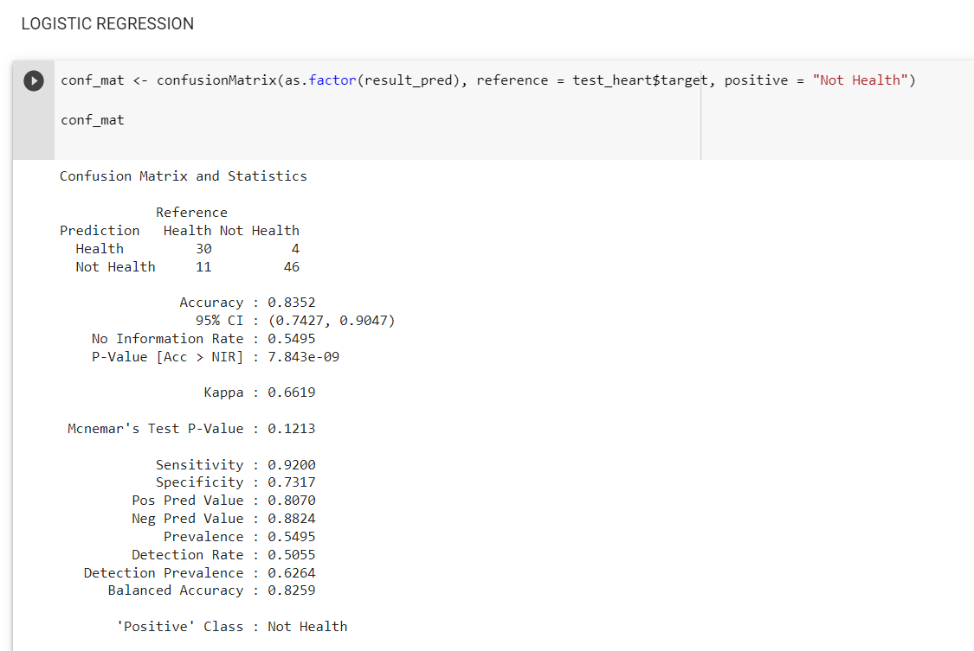

Slide 25
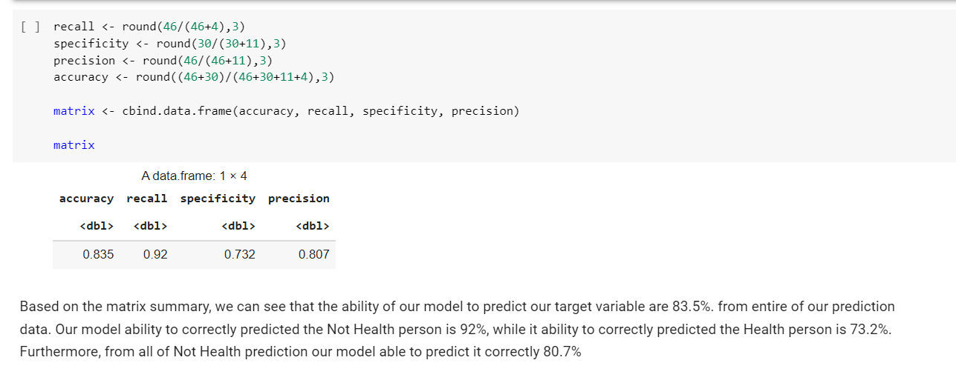

Slide 26
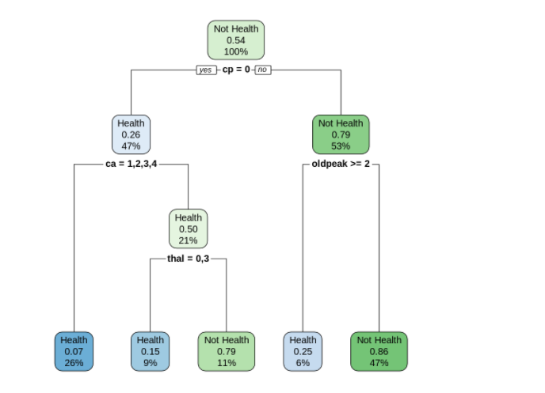
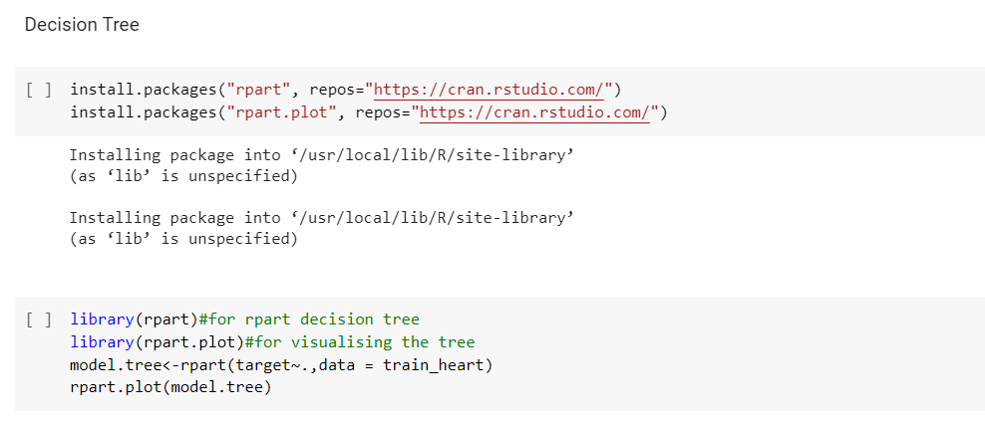

Slide 27
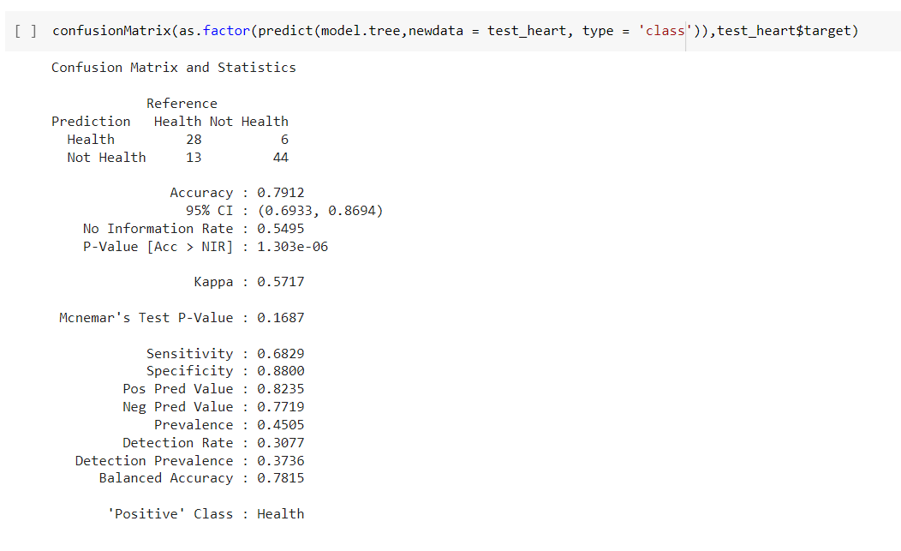

Slide 28
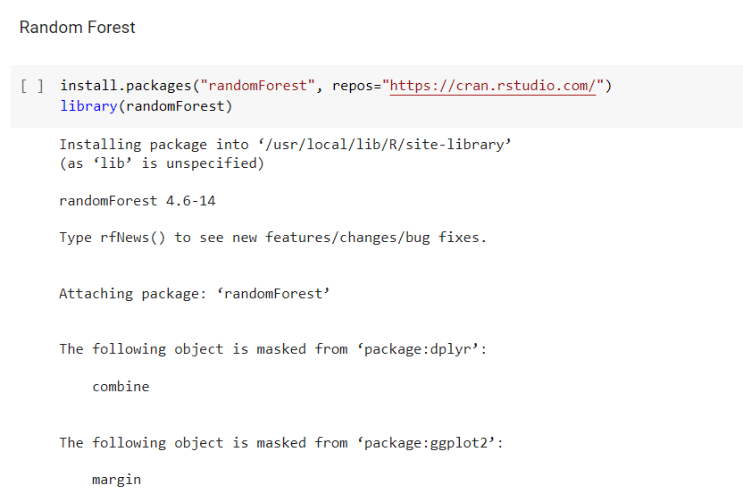

Slide 29
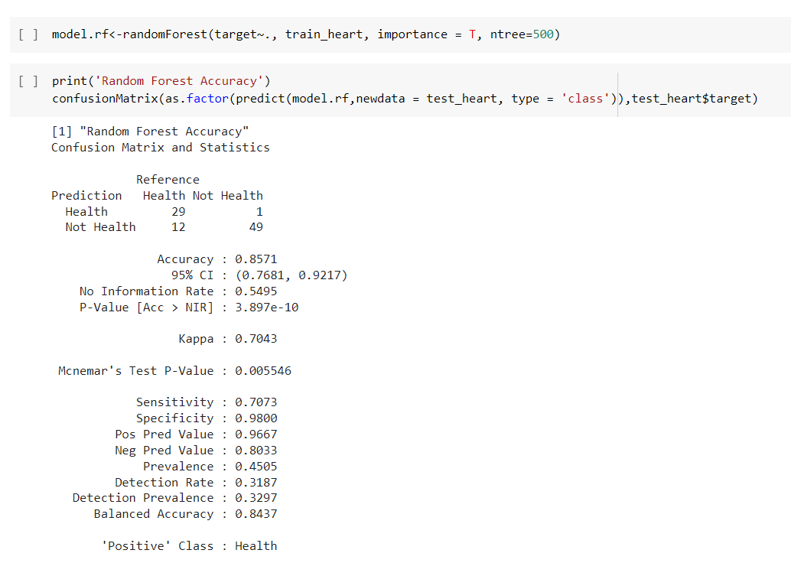

Slide 30
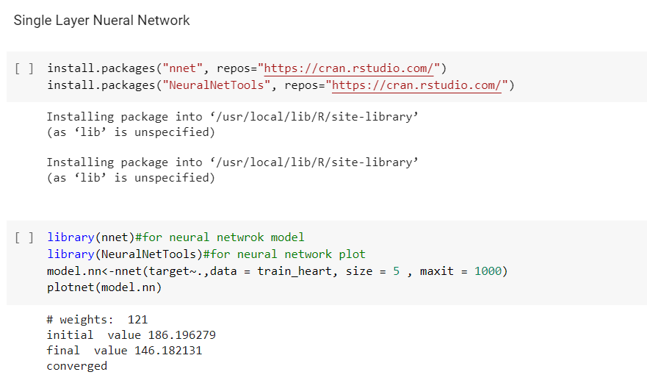
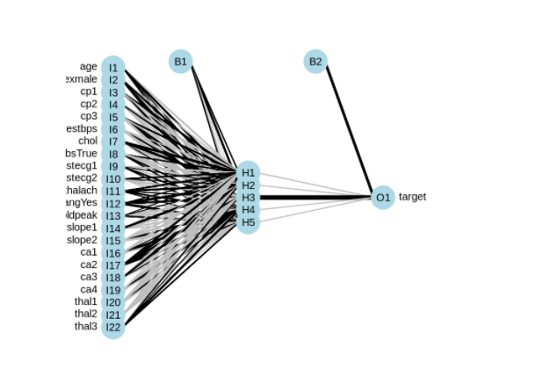

Slide 31
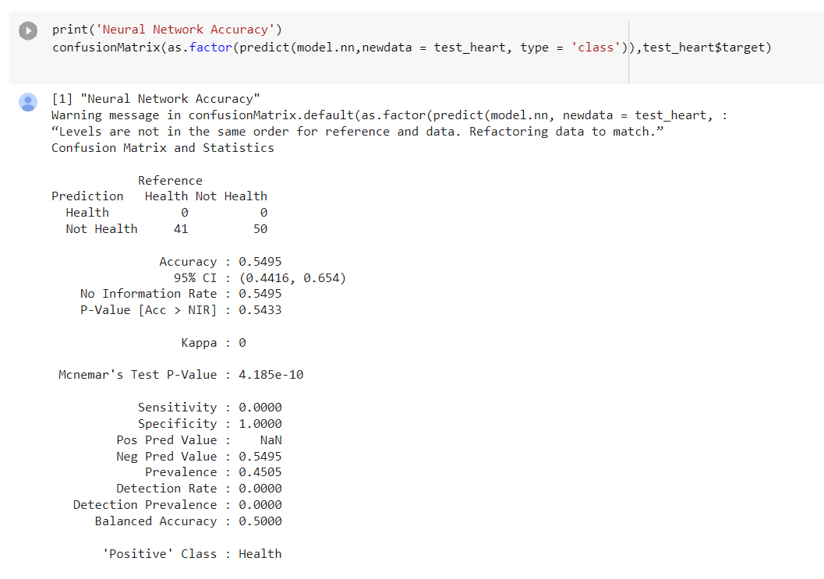

Slide 32
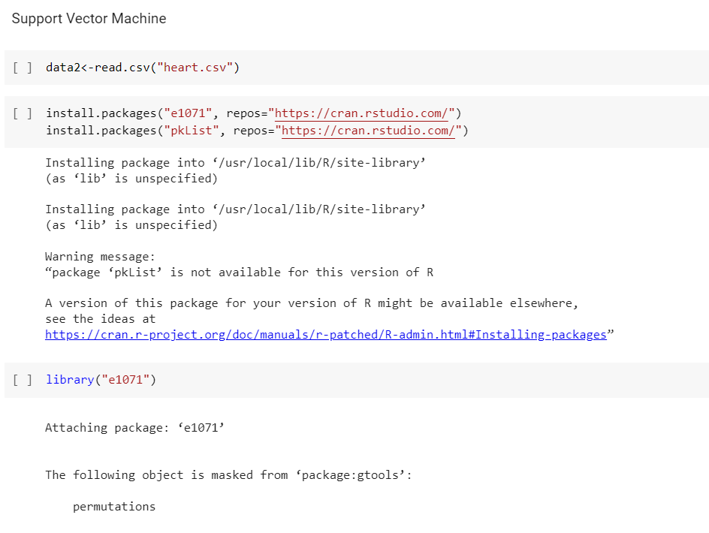

Slide 33
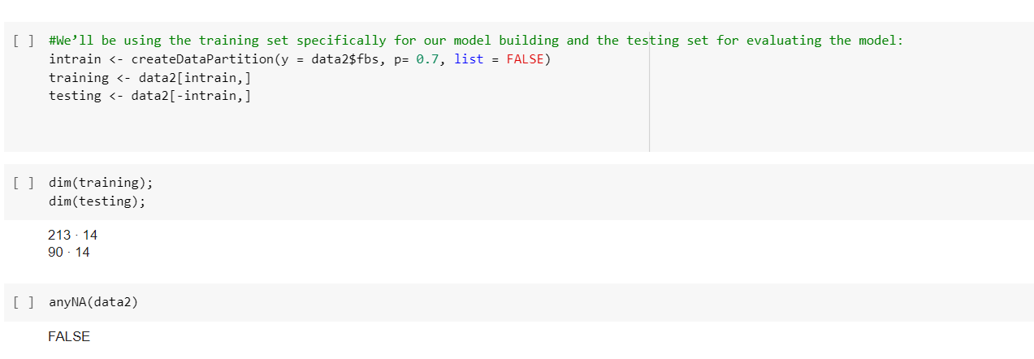
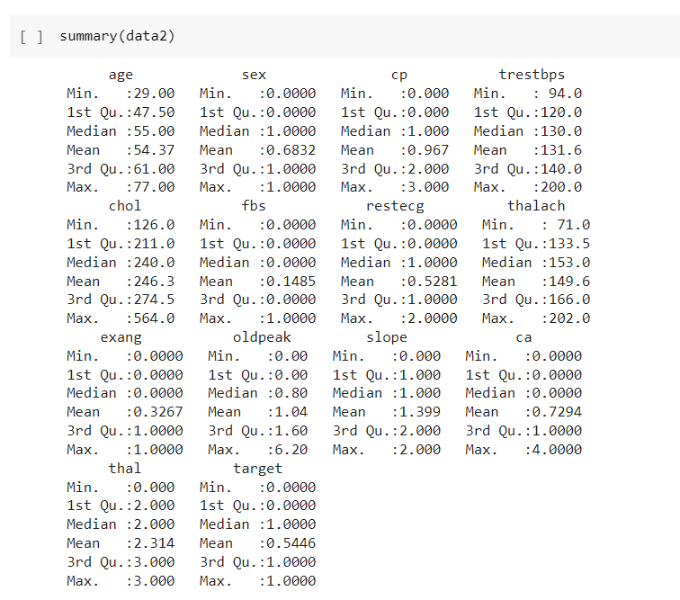

Slide 34
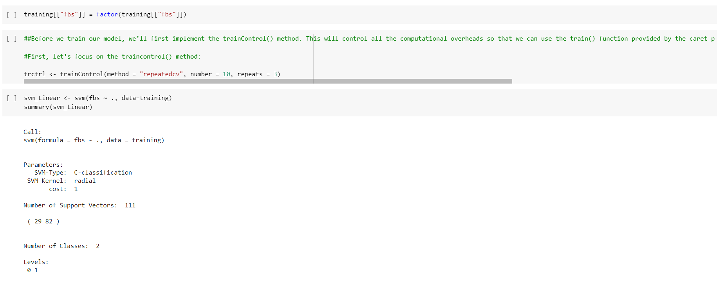

Slide 35
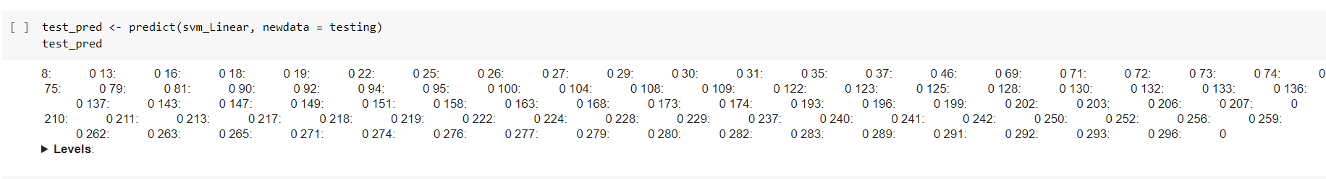
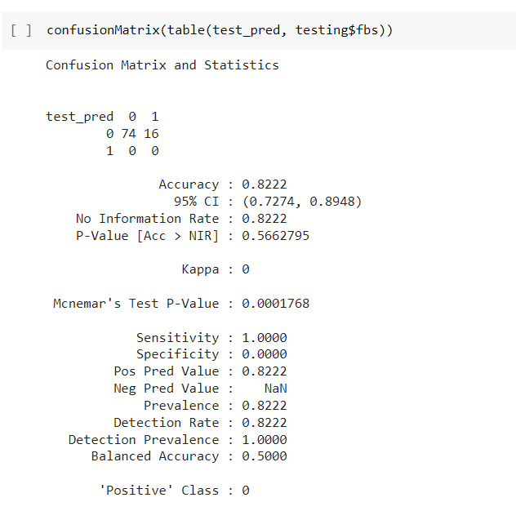

Slide 36
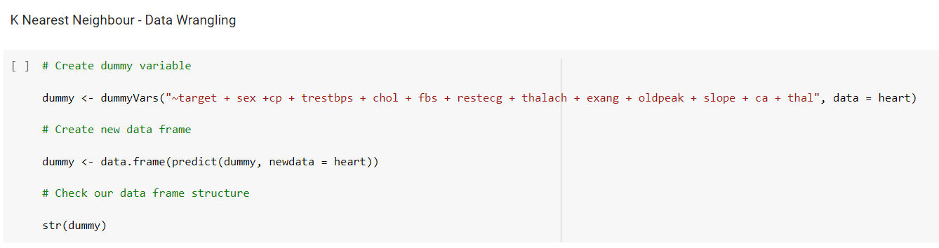
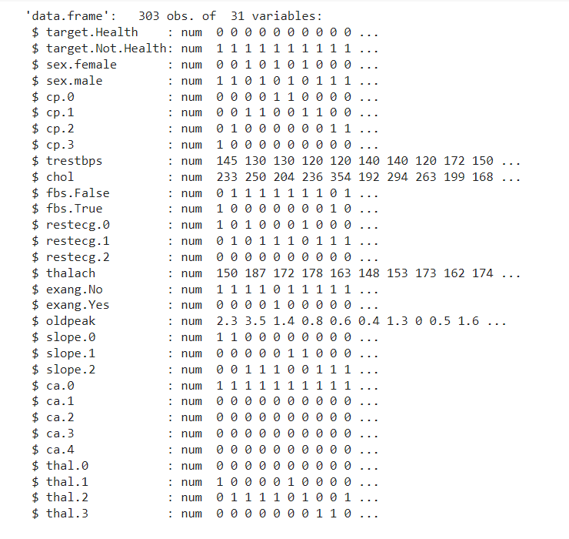

Slide 37
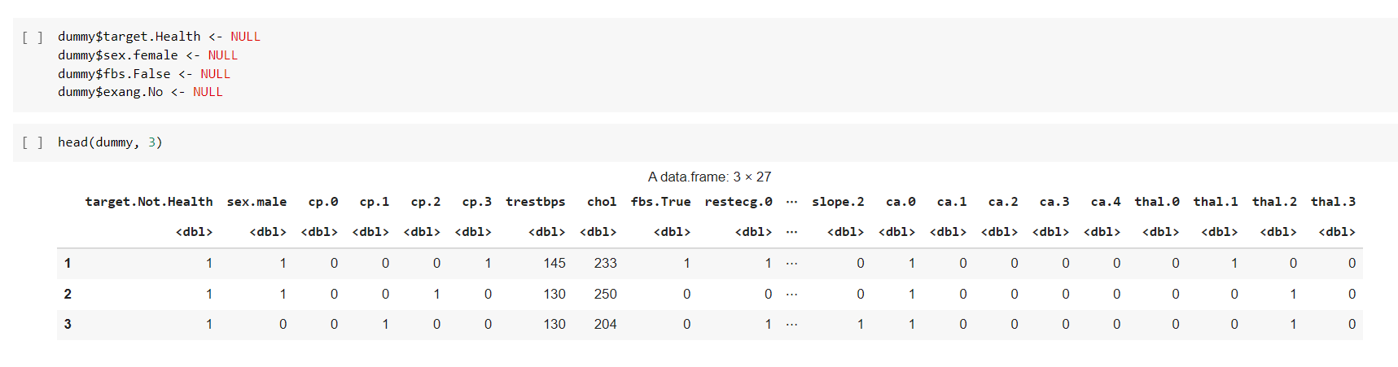

Slide 38
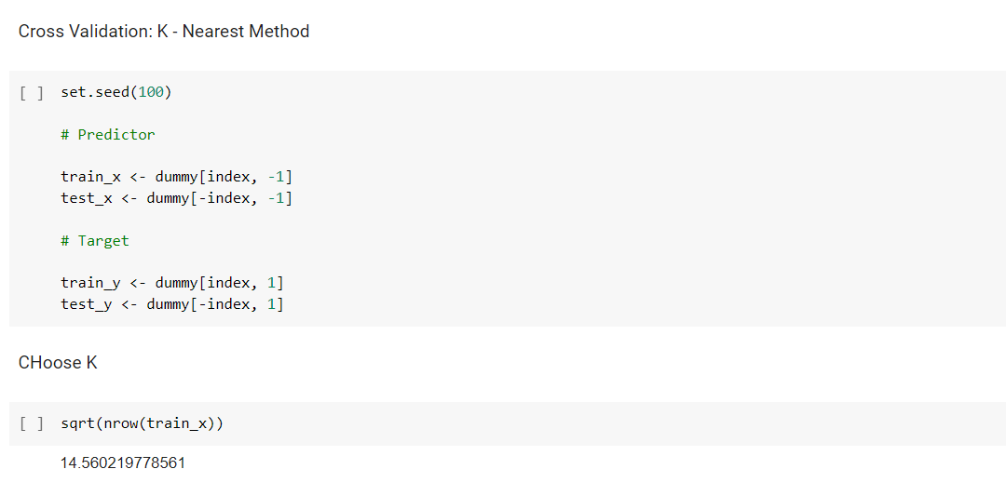
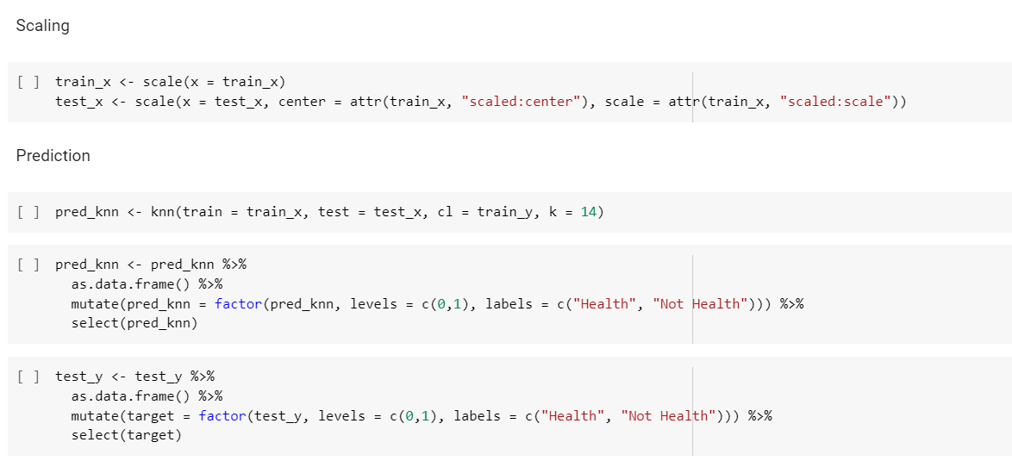

Slide 39
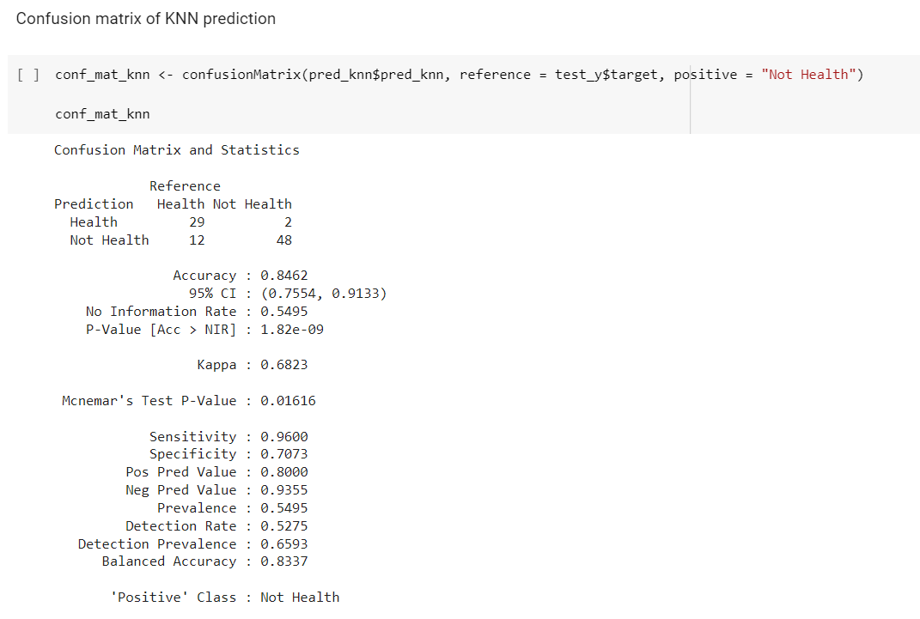
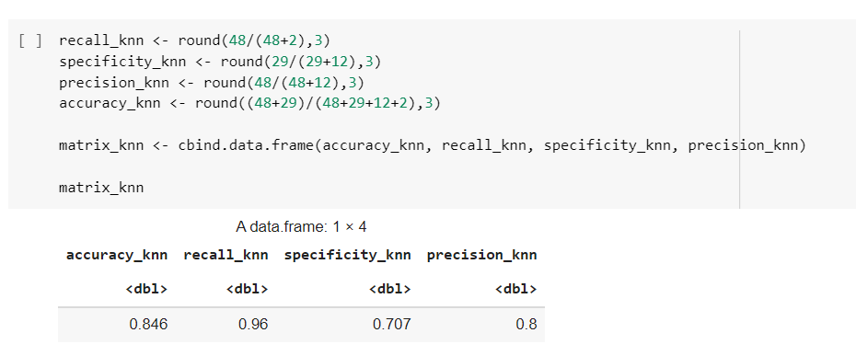

Slide 40
Conclusion
When we had performed logistic regression : from all the not health prediction, the model was able to predict it correctly by 80.7%.
In decision tree the accuracy was 0.7912.
In random forest the accuracy was 0.8571
In neural network the accuracy was 0.5495
In SVM, the accuracy was 0.8222
In Knn , the accuracy was 0.8462
So we can conclude that highest accuracy was when we performed random forest.

Slide 41
THANKYOU

